Slide 1

Project Title – AIR BNB HOTEL BOOKING ANALYSIS
[Student Name: THIRUNAHARI HARSHINI ]
[AICTE Internship ID:STU664223855726e1715610501]

Slide 2

PROBLEM STATEMENT
The primary objective of this project is to develop a robust machine learning model capable of accurately predicting the price of an Airbnb listing in New York City. By analyzing a comprehensive dataset containing features such as location (neighbourhood group, long), property characteristics (room type, Construction year), booking policies (minimum nights, cancellation_policy), and host reputation (number of reviews, review rate number), we aim to identify the key drivers of pricing. The goal is to create a predictive tool that can effectively estimate a listing's price based on its unique attributes, providing valuable insights for both hosts and guests in the dynamic NYC rental market.

Slide 3
Project Description
This project entails a complete data science workflow to build an Airbnb price prediction model for New York City. The process will begin with data cleaning and preprocessing to handle missing values and ensure data quality, followed by an in-depth exploratory data analysis (EDA) using libraries like Matplotlib and Seaborn to visualize trends and uncover relationships between variables. Subsequently, we will perform feature engineering to create new, informative features that enhance predictive power. The core of the project will involve building and training several regression models, such as Linear Regression and Random Forest, and then rigorously evaluating their performance using metrics like Mean Absolute Error (MAE) and R-squared (R2) to select the most accurate model. The final outcome will be a trained predictive model and a detailed analysis offering actionable insights into the factors that determine Airbnb pricing in the city.

Slide 4

WHO ARE THE END USERS?
Airbnb Hosts: To set optimal and competitive pricing for their properties, maximizing their income and booking rates.
Guests and Travelers: To verify if a listing is fairly priced compared to similar properties, ensuring they get the best value.
Airbnb (The Company): To enhance their "Smart Pricing" tools, understand market dynamics, and improve the overall platform experience for both hosts and guests.
Real Estate Investors: To analyze the potential rental income and return on investment (ROI) of properties they are considering for short-term rentals.
Market Analysts: To gain insights into the urban real estate and tourism markets, using the data for economic reports and research.

Slide 5

Technology Used
Programming Language: Python
Core Data Science Libraries: Pandas (for data manipulation), Matplotlib & Seaborn (for data visualization).
Machine Learning Library: Scikit-learn (sklearn) for model building, preprocessing, and evaluation.
Development Environment: Jupyter Notebook / Google Colab.

Slide 6
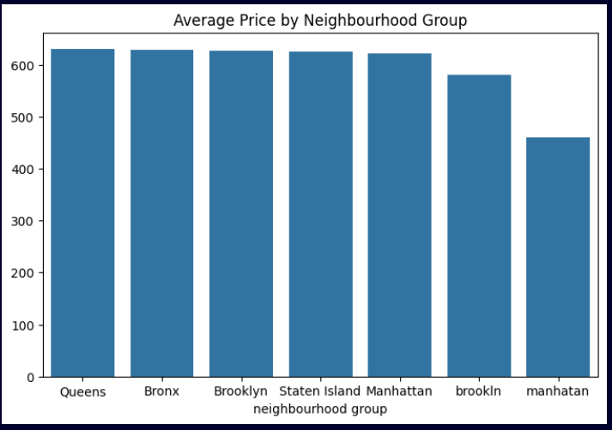
RESULTS1
Demo Link

Slide 7
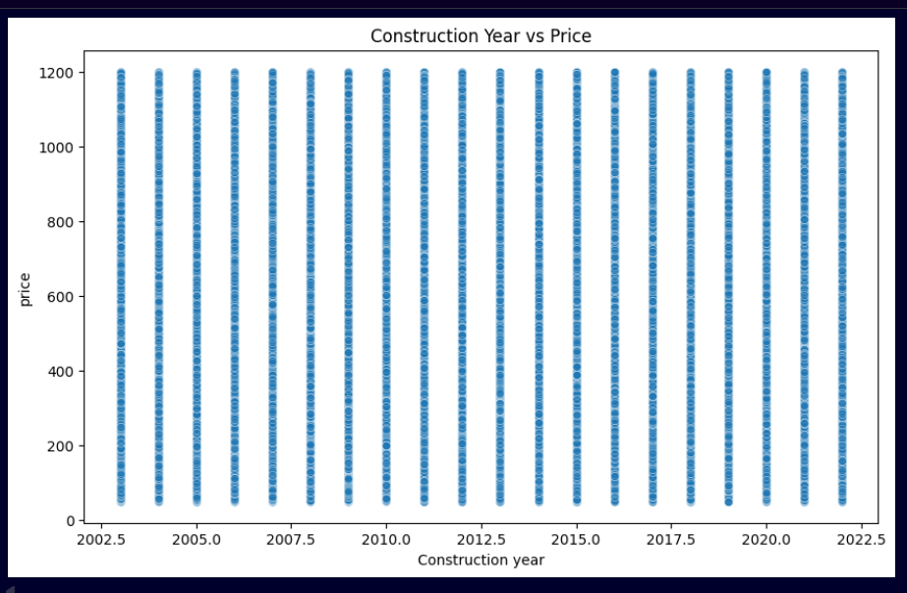
RESULTS2
Demo Link

Slide 8
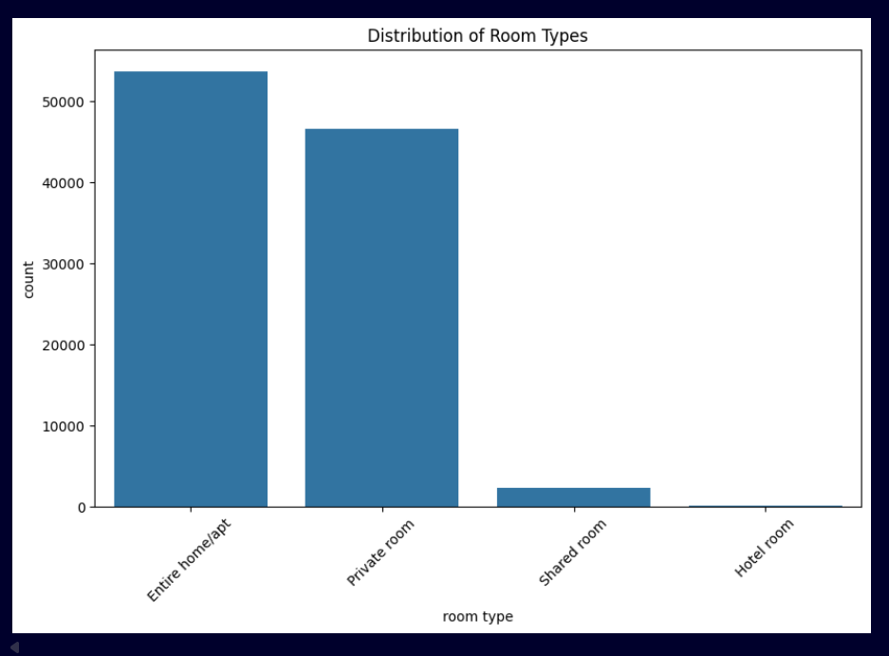
RESULTS3
Demo Link

Slide 9
GitHub repository
Git link: Harshini2226/VOIS_AICTE_Oct2025_THIRUNAHARI_HARSHINI
OR
https://github.com/Harshini2226/VOIS_AICTE_Oct2025_THIRUNAHARI_HARSHINI
Demo Link

Slide 10
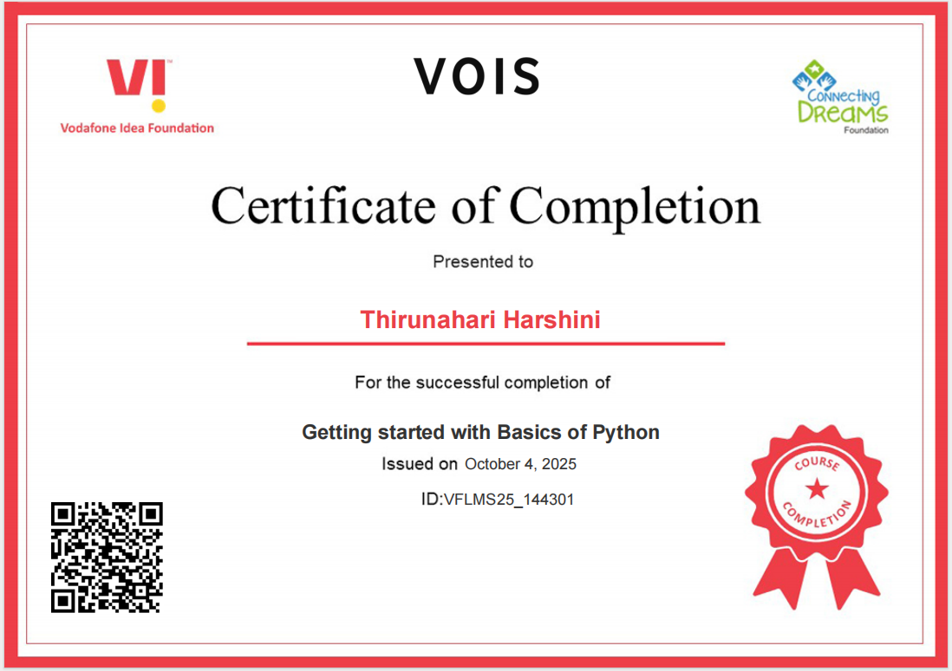
Getting started with Basics of Python Certificate

Slide 11
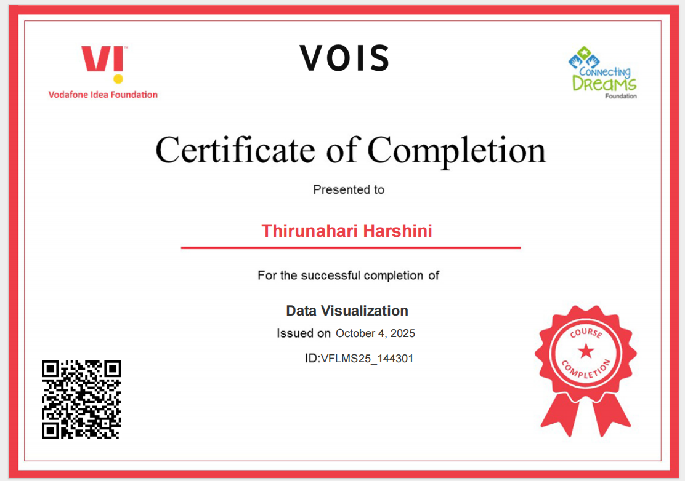
Data Visualization Certificate

Slide 12
Thank you
.
.

